Slide 1

How do you manage your research data?
Data sharing and Backup
Anne Pajon 26th February 2019 Mark Fernandes (Updated Nov 2019)
What kind of research data do you have?
Do you do any data backup?
How often?
How do you share files/data with collaborators?
This work is licensed under a Creative Commons Attribution 4.0 International License.

Slide 2
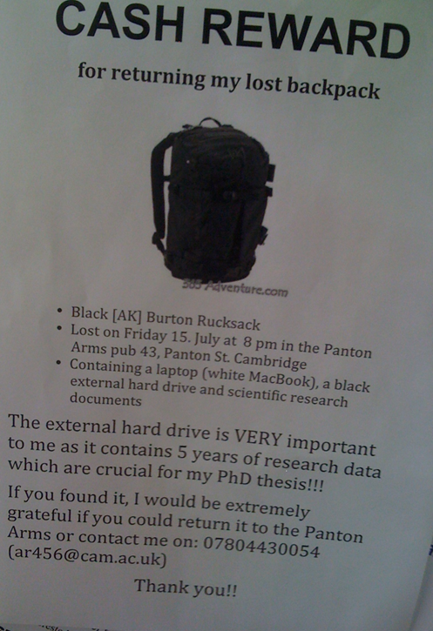
To avoid data disasters ... What would you do if you’d lose your data tomorrow?
xxxxxxxxxxx
xxxxxxxxxxxxx
https://blogs.ch.cam.ac.uk/pmr/2011/08/01/why-you-need-a-data-management-plan/

Slide 3
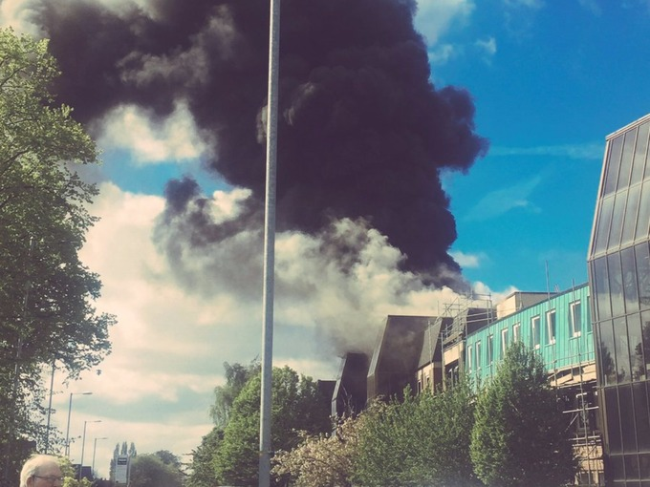
What if?
Cancer Research UK – University of Manchester – 27 April 2017
Notes:
Why file organization of your research data is important
Specific techniques for organizing your research data,
including developing plans for:
– File structures - where to put data so you won’t lose it
(including tips on embedding metadata)
– File naming - what to call data so you know what it is
– A bit on version control - keeping track of data
• Will also include opportunities for:
– Small group discussion
– Exercise for organizing your own data
• Focuses on research data, but applies to other types of files as well

Slide 4

What would you do if you’d lose your data tomorrow?
Your laptop got stolen
Your office/house burnt
Your USB stick is lost
Your portable hard disk is damaged
Your data in Dropbox disappeared
https://en.wikipedia.org/wiki/The_Scream
Notes:
Why file organization of your research data is important
Specific techniques for organizing your research data,
including developing plans for:
– File structures - where to put data so you won’t lose it
(including tips on embedding metadata)
– File naming - what to call data so you know what it is
– A bit on version control - keeping track of data
• Will also include opportunities for:
– Small group discussion
– Exercise for organizing your own data
• Focuses on research data, but applies to other types of files as well

Slide 5
As stated in the first talk: Never work directly on the raw data
Leave it intact
Always make a copy, and work on the copy

Slide 6
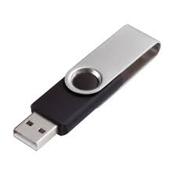
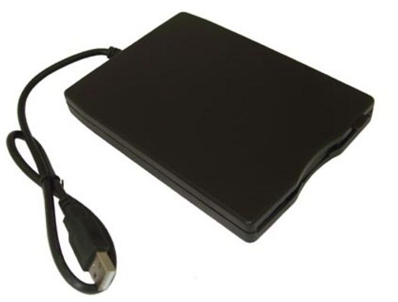

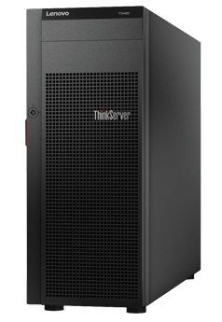




Data backup
At least 2 backups at 2 different locations
External disks
Online backup
Servers
Department
College
IT
Cheap
£10-15 / TB (1024GB)
Accessibility
Free (limit)
Managed by experts
Failure rate
1.5%/year
Personal data
Hacking
Moving between institutions

Slide 7

Data backup
Manual
Automated
- Install software
e.g. Time machine (Mac users) Syncback(Windows) https://www.2brightsparks.com
Copying files to relevant folders
- RAID technology
- Checksums
Automatically upload files to the cloud when any changes are saved
Copying files to relevant folders

Slide 8



If manual … how often?
How much would you be willing to lose?
1 day
1 week
1 month-year
Software allows you to set up backup time
automatically

Slide 9
Data backup and file sharing
Space/price
2 GB (free)
2 TB (£96/year)
15 GB (free)
2 TB (£80/year)
5 GB (free)
1 TB (£60)
File history and recovery
Yes, unlimited
Yes
Last 90 days
File size limit
None
Up to 5 TB
15 GB
Support
UIS
UIS
UIS
OS
Windows, Mac, Linux,
Android, iOS
Windows, Mac,
Android, iOS
Windows, Mac,
Android, iOS
Accessibility
Sync anywhere on any devices
Live editing
Integration with Microsoft Office

Slide 10



Beware of the cloud…
reliability
Is the cloud storage supplier reliable?
security
Have you lost control over your data?
cost
Is there hidden cost?

Slide 11
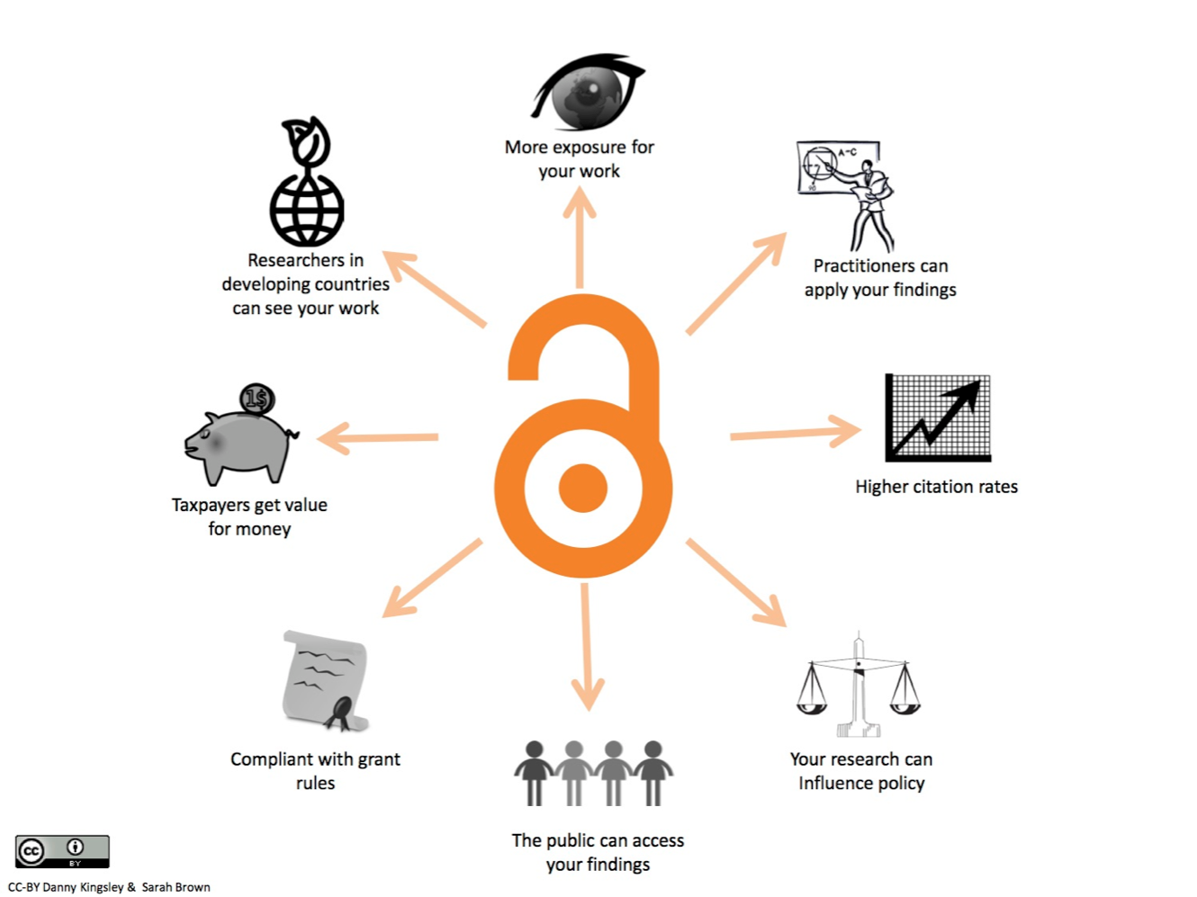
Why data sharing is important?
Data should be shared to move our knowledge forward.

Slide 12
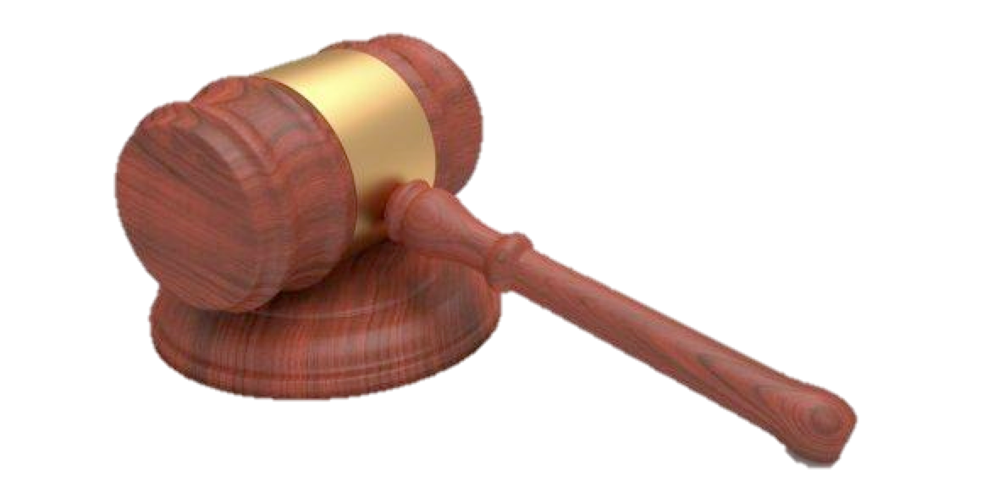
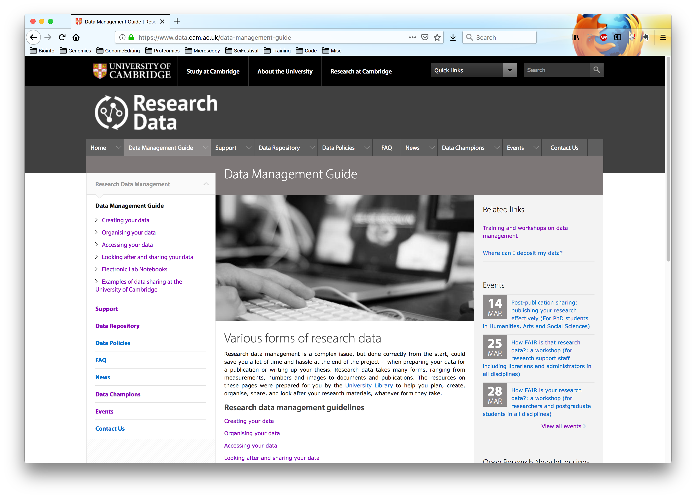
Research Data Policies
http://www.data.cam.ac.uk/data-management-guide
Most research funders have also introduced policies on research data management.
The general expectation is that publicly funded research data are a public good, and should be made openly available with as few restrictions as possible.

Slide 13



What data to share?
Data & metadata
Raw
Processed
Code (software and scripts)
Methods
Papers
results and figures
What about non-positive results?
RIO - Research Ideas and Outcomes
Would you consider Pre-Print for your draft manuscripts?
https://riojournal.com/
https://doaj.org/
https://www.biorxiv.org/

Slide 14
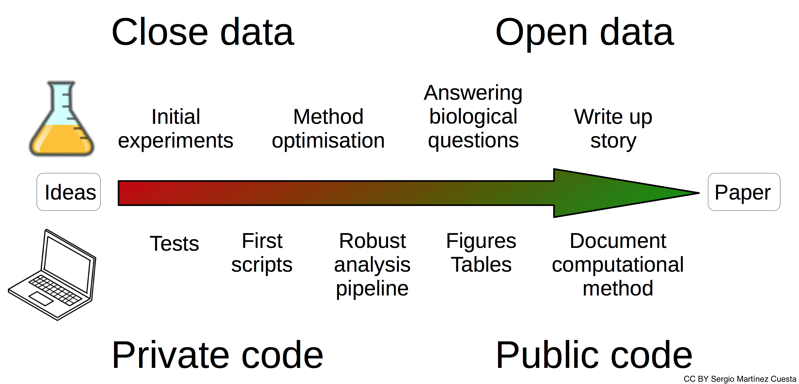
When to share?

Slide 15




Gather information early
Think of data submission from the start
Collect metadata before submission
Keep a ReadMe file about your project
Consider using an Electronic Lab Notebook

Slide 16



How to share your data?
Store, describe and deposit your data in suitable and trusted public data repositories and add a link to your data in your publication.
Repositories for data
Discipline specific
Registry of Research Data Repositories http://www.re3data.org/
EMBL-EBI services https://www.ebi.ac.uk/services
General purpose
Zenodo https://zenodo.org/
Repositories for code
GitHub https://github.com
GitLab https://gitlab.com
Bitbucket https://bitbucket.org
Zenodo assigns a Digital Object Identifier (DOI) to make the upload easily and uniquely citable, with GitHub integration to enable tracking of each release.

Slide 17
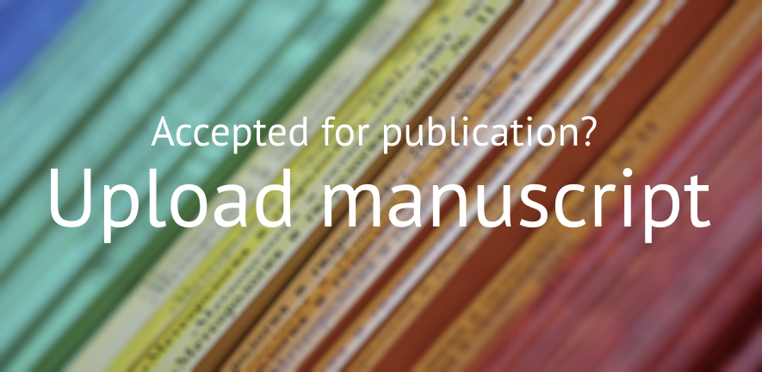


How to make your publication Open Access?
The Open Access Team will check your funder and journal policies and advise on how to comply with Open Access requirements.
https://www.openaccess.cam.ac.uk/

Slide 18
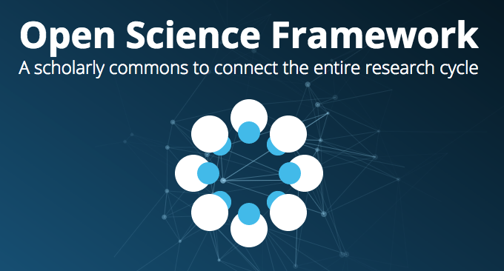
Open Science Framework
Cloud-based management for your projects @ https://osf.io/

Slide 19
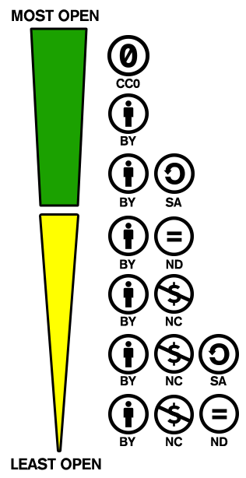

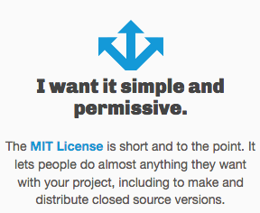
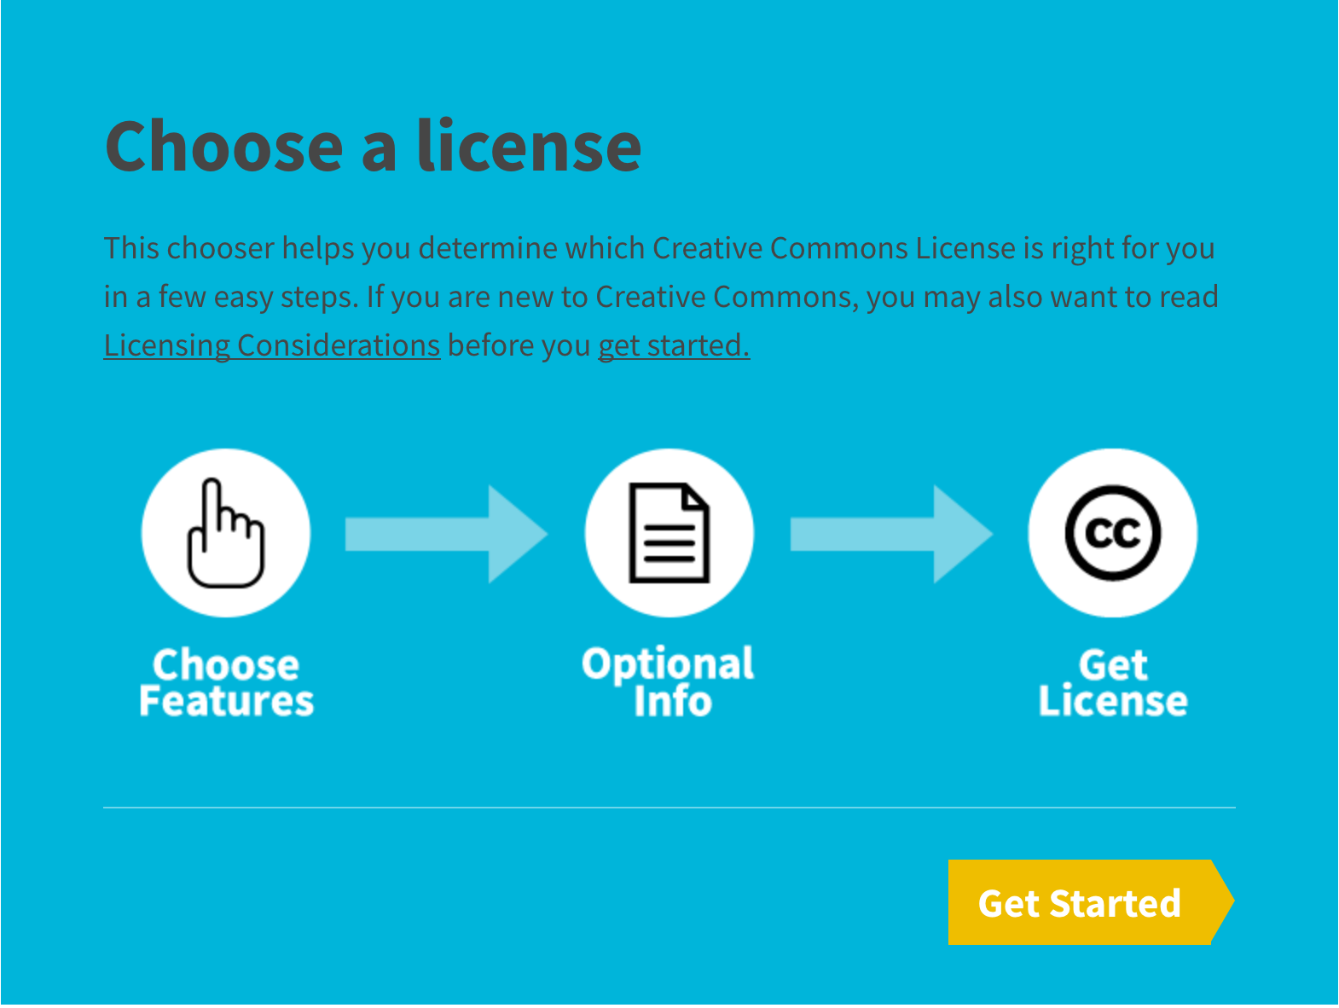

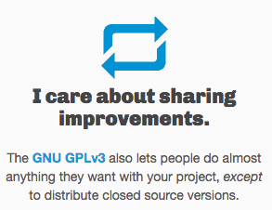
Under which license?
Creative work is under exclusive copyright by default.
Share your data with one of the Creative Commons licenses
Share your code with one of the open source licenses
https://creativecommons.org/
https://opensource.org/licenses
They allow software to be freely used, modified, and shared.
https://choosealicense.com

Slide 20

Open Access Policy
As a CRUK-funded researcher, if you have an original primary article accepted for publication in a peer-reviewed journal, you must ensure that:
An electronic copy of the final, published form of your paper is available on Europe PubMed Central (Europe PMC) as soon as possible and no later than 6 months after publication.
If you've paid an article processing charge (APC) for the Europe PMC deposit, your paper must be published with a CC-BY license, so that it may be freely copied and reused, providing that the original authors are properly credited. Other licenses will not be compliant with your Grant Conditions.
The journal you publish in must be published by a publisher who has agreed to the COAF/Wellcome Trust publisher requirements.
https://www.cancerresearchuk.org/sites/default/files/policy_on_open_access.pdf

Slide 21

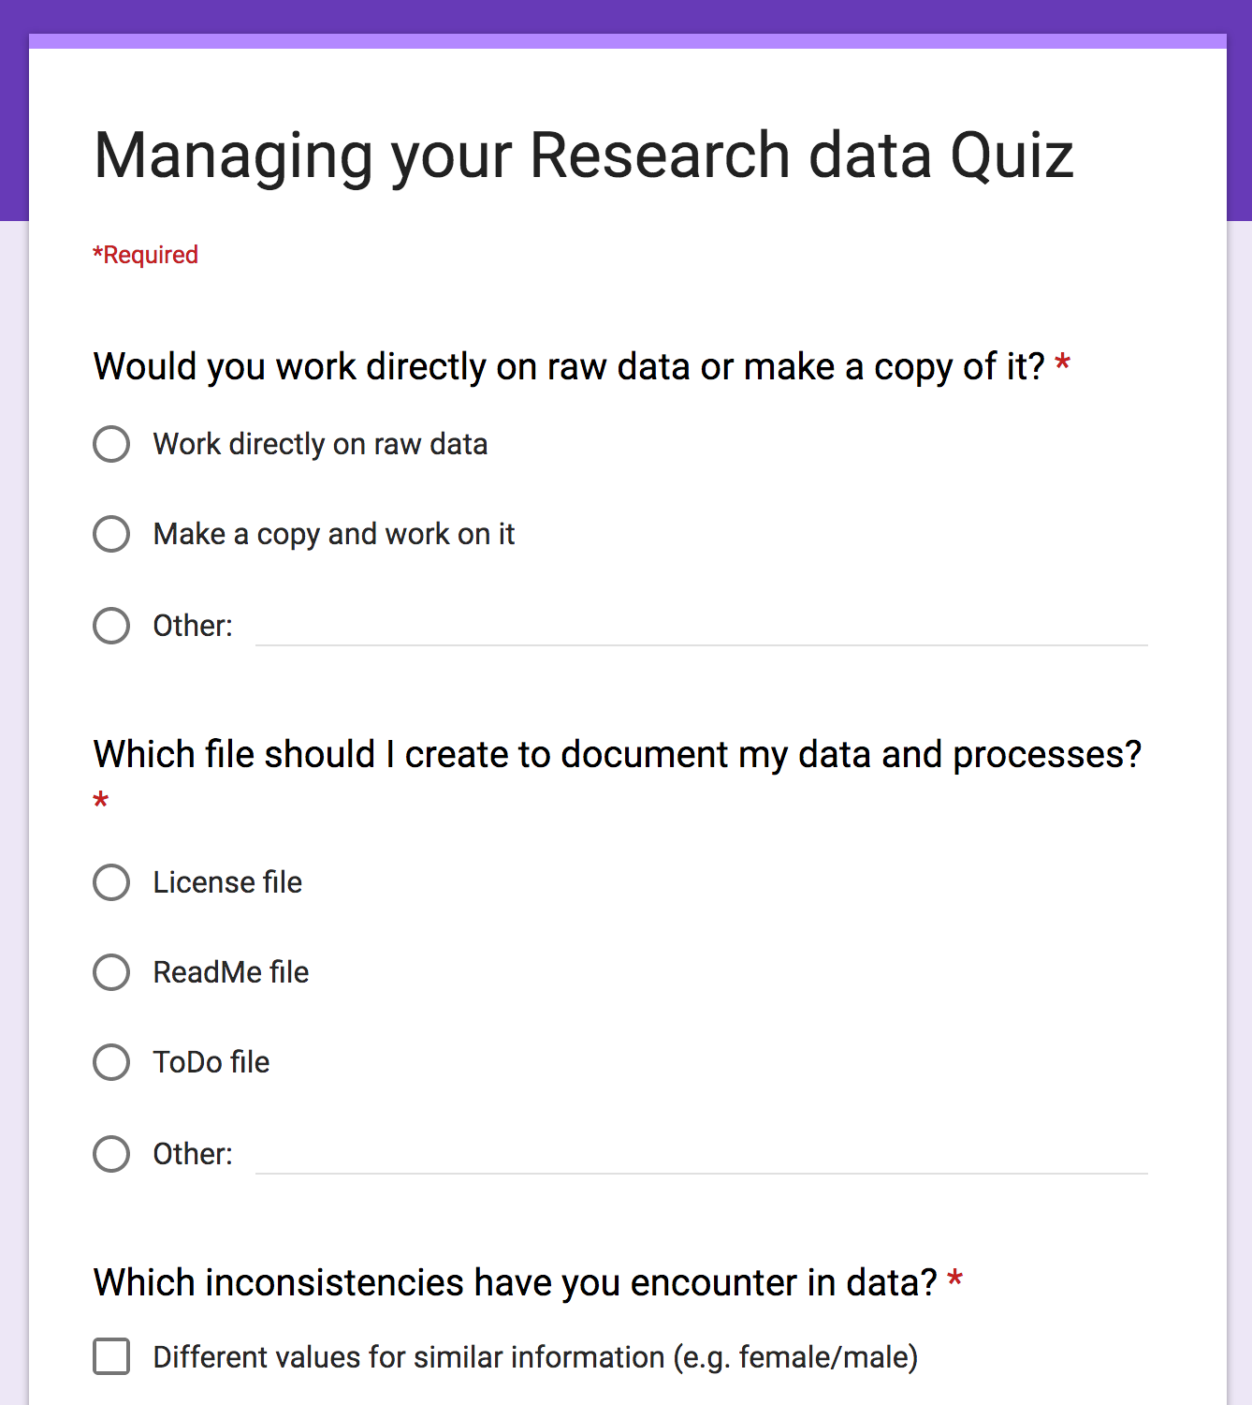
Quiz
https://frama.link/manage-data-quiz

Slide 22




Conclusion
Always make a copy of your data
Backup your data at least twice at two different locations
Document your process using a ReadMe file
Ideally most data should be shared
Sharing is essential for all publicly funded research
Share as early as possible
Using suitable repositories and DOI
Share your work under a Creative Commons
or Open Source license

